Slide 1


Xamarin
Telerik UI for Xamarin
Allan Pead - @adpead - http://bit.ly/2mrVle6
Xamarin Insider, Xamarin Premier Consultant Partner

Slide 2
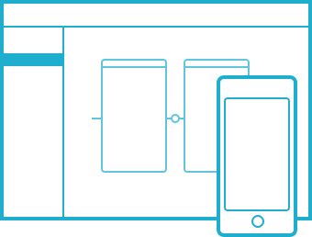
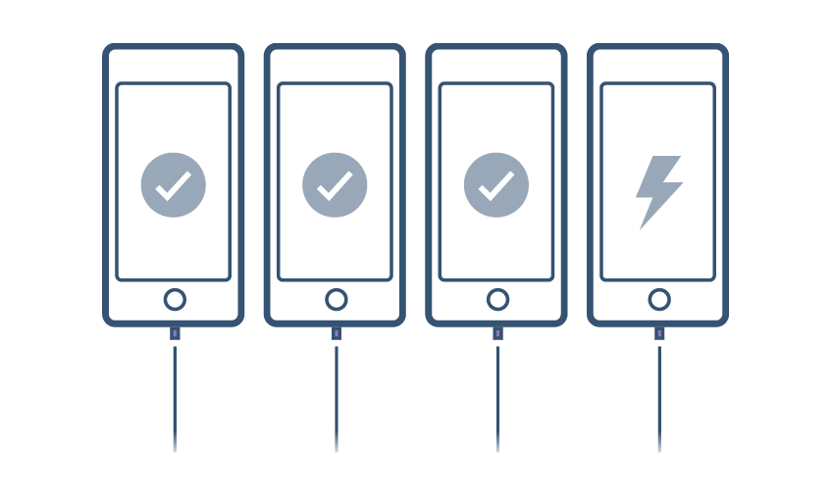
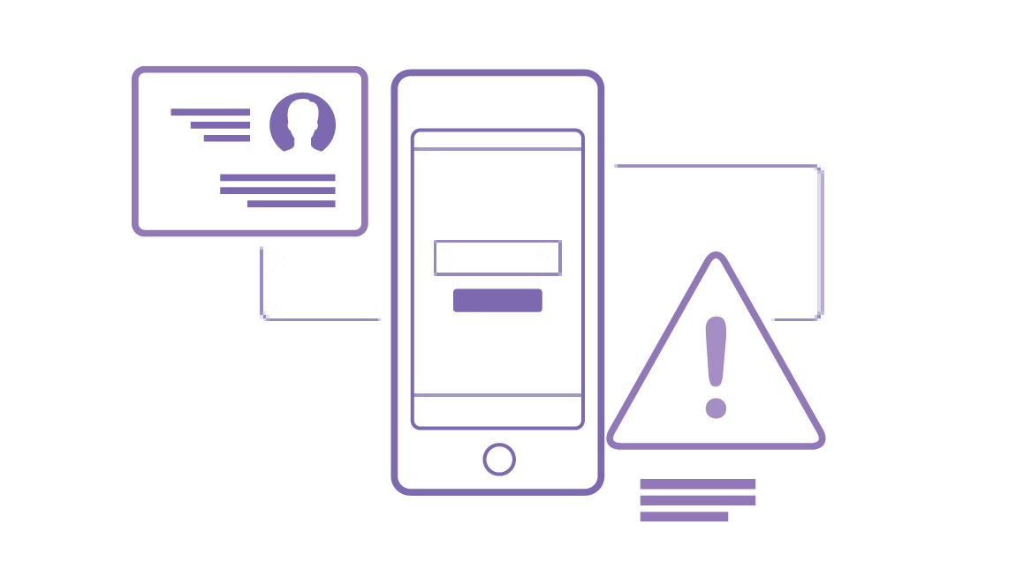






Complete mobile lifecycle solution
BUILD
TEST
MONITOR
ACCELERATE
One platform to build native apps for iOS and Android
Test any app on 2,000+ real devices in the cloud
Monitor performance and user behavior in live apps
Train your team and accelerate projects with deep expertise

Slide 3
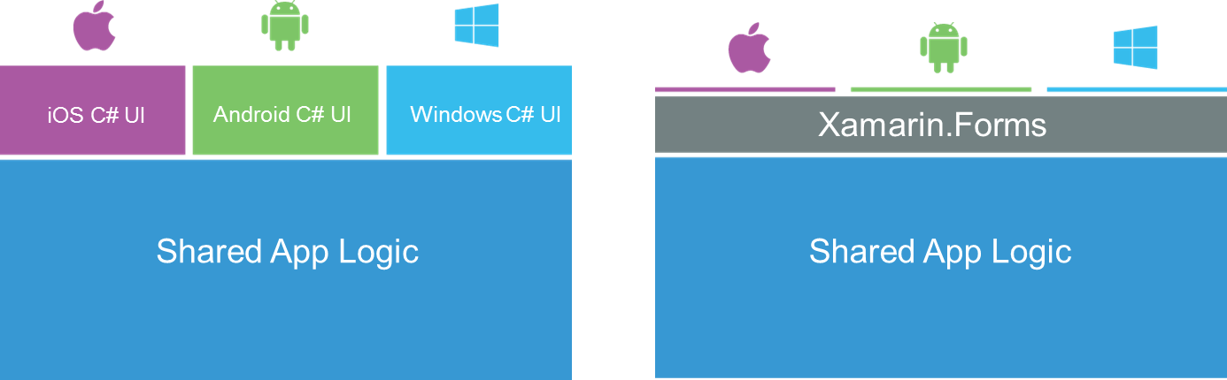
Xamarin’s Unique Approach
Xamarin exposes 100% of the native APIs for iOS, Android and Windows

Slide 4
Components to build apps faster

Slide 5

Telerik UI for Xamarin

Slide 6
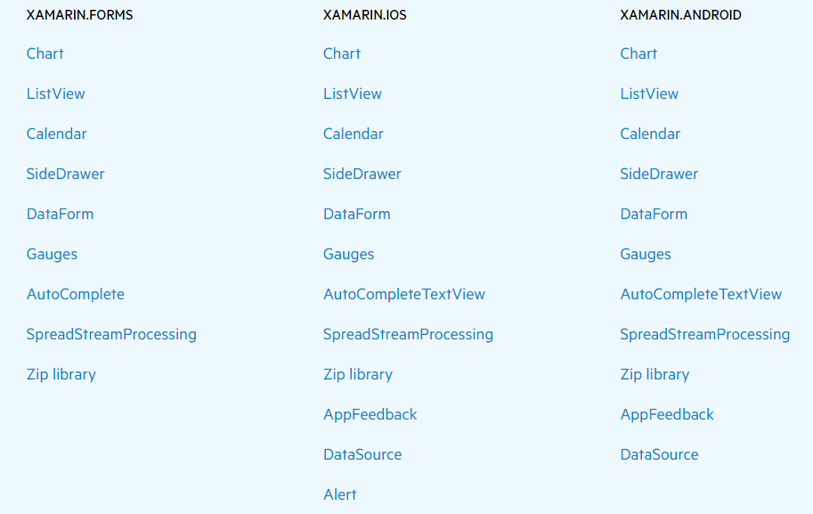
Telerik UI for Xamarin, What’s in it?

Slide 7






Telerik’s Components

Slide 8

Telerik UI for Xamarin Pricing

Slide 9
Telerik’s UI For Xamarin Cross Platform

Slide 10
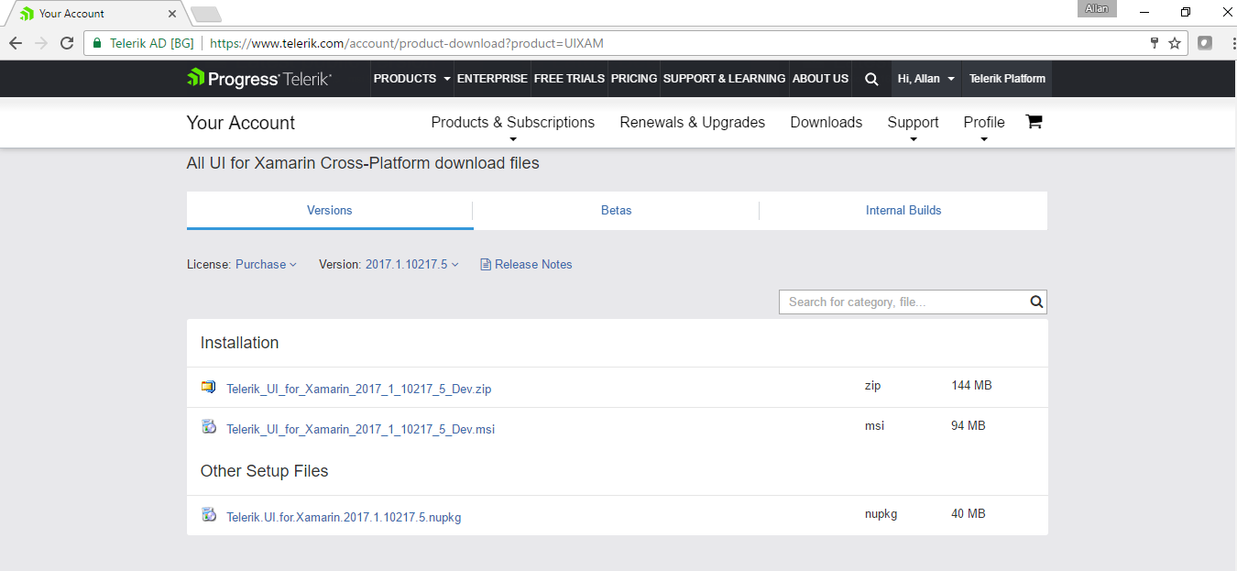
Starting with Telerik

Slide 11
Telerik UI for Xamarin
Live DEMO

Slide 12
Thank you!
Download the Trial Now
https://www.telerik.com/download-trial-file/v2/ui-for-xamarin
Where to get help with Telerik
http://docs.telerik.com/devtools/xamarin/
Xamarin Learning Resources
https://developer.xamarin.com/guides/
Xamarin University
https://www.xamarin.com/university
Learn and share with your local community
Xamarin User Groups
Cape Town (@CTXUG)
Johannesburg (@GXUGSA)
Durban (@DXUGSA)
Local Slack Community
https://zatech.slack.com #xamarin
My personal details
adpead@gmail.com
@adpead
http://www.explorationspace.co.za/

